Slide 1

Guidehouse 1B - Predicting Ukraine’s Emerging Humanitarian Needs
AI Studio Final Presentation
Break Through Tech New York @Cornell Tech
December 8, 2023

Slide 2

Introductions

Slide 3






Meet Our Team!
<insert jpg>
<insert jpg>
<insert jpg>
Yana Kuzmina Hunter College
Computer Science BA
Elena Lukac Barnard College
Computer Science BA
Robert Ortiz College of Staten Island
Computer Science BS
<insert jpg>
<insert jpg>
Merlyn Pothen Queens College
Computer Science BS
Sofya Seredina Baruch College
Computer Information Systems BBA

Slide 4

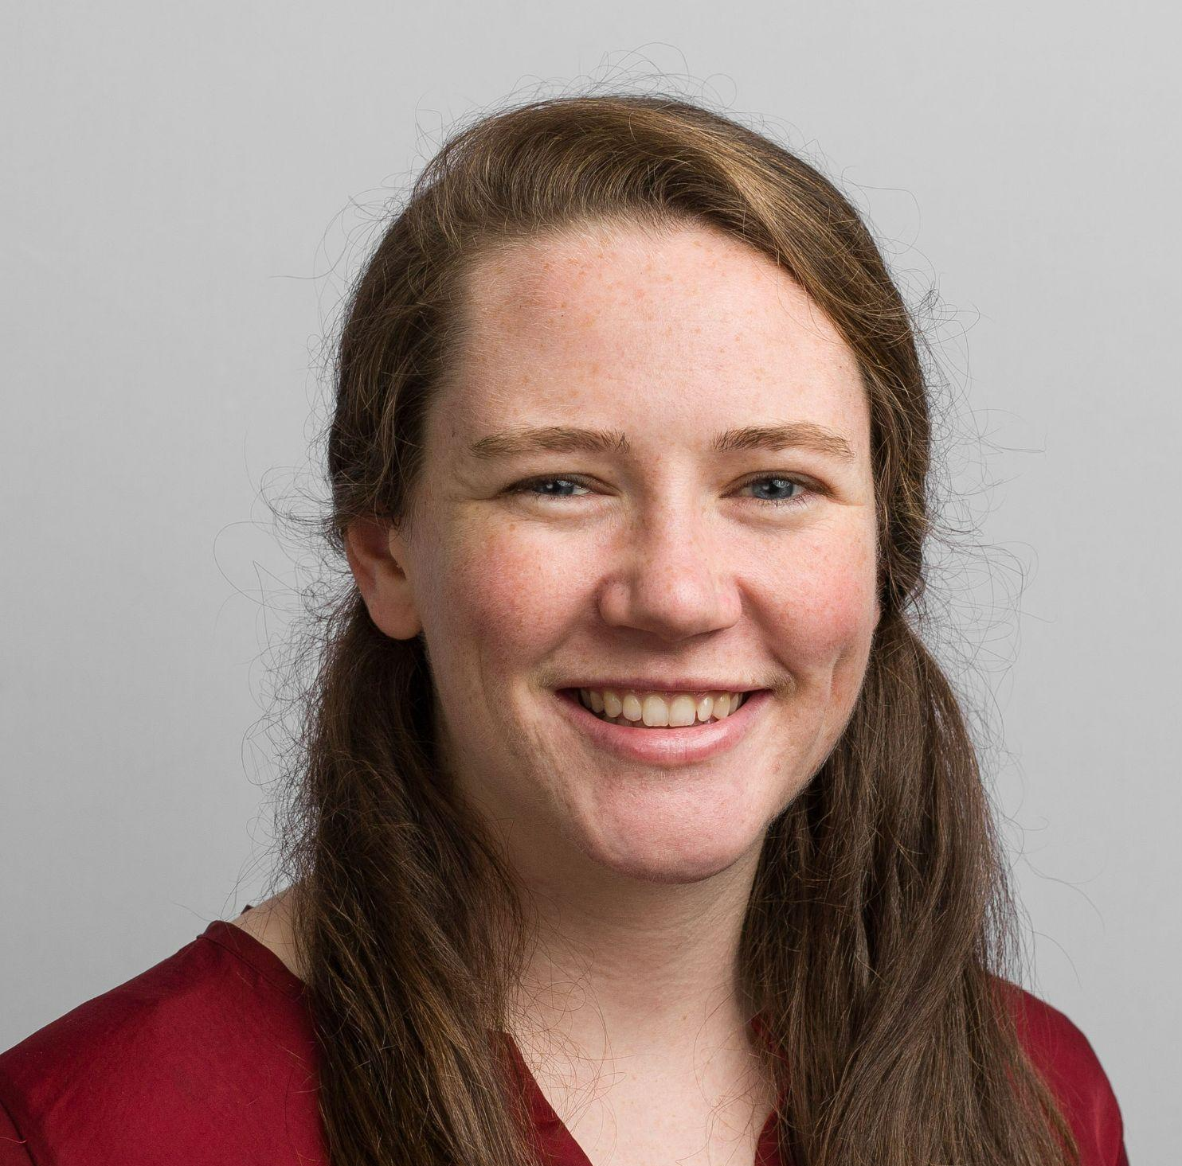
Our AI Studio TA and Challenge Advisor
<insert jpg>
<insert jpg>
Cindy Deng AI Studio TA
-
Cornell Tech Master Student, Computer and Information Science Major
Bridget Treseler Challenge Advisor
-
Managing Consultant
Guidehouse,
Technology Advisory (AAIA)

Slide 5
Presentation Agenda
Project Statement and Overview
Data Understanding & Data Preparation
Modeling & Evaluation
Model Insights
Final Thoughts

Slide 6
AI Studio Project Overview

Slide 7
“
In [February of 2022], Russia invaded Ukraine and deepened an ongoing humanitarian crisis in the region. Many United States federal agencies are responsible for coordinating and managing the US’s response to this ongoing crisis. However, looking at historical data alone will only ever enable a reactive stance. Using AI/ML methods of your choosing, please predict future humanitarian needs within Ukraine to enable a more efficient, effective, and proactive response to the ongoing crisis.
Notes:
[INSERT PROJECT DESCRIPTION]
Potential things to talk about while this slide is up on the screen:
What type of ML challenge is this? (E.g., supervised classification or regression; unsupervised clustering or association)
What type of data were you dealing with? (E.g. public domain data in csv format; company-provided image data)
What did your team find interesting or compelling about the challenge? (Definitely include this!)
You can use the description you shared in your Project Scope & Deliverables document, assuming it is still accurate. Make sure your description is not too wordy.

Slide 8
Our Goal
Identify datasets that provide relevant information on humanitarian needs in Ukraine.
Create reliable model with high accuracy.
Create diagrams and graphs using models to visually represent findings.
Draw meaningful conclusions through model evaluation and visualization.

Slide 9
Business Impact
Contracting models can help to tackle what Ukraine humanitarian needs will increase in near future
Identifying the needs that are most “needed” in each oblast (area) will help with identifying what kind of help each oblast need the most.
Identifying oblasts (areas) that need more help will help make a decision where funding is needed the most.
Identifying how needs change over time and how the number of organizations increases over time.

Slide 10
Our Approach
Data Identification & Understanding
Searched through databases containing relevant data sets, frequently speaking with CA to understand our business question and what data is needed.
Modeling & Evaluation
Created Gradient Boosted Regression models to predict specific humanitarian needs and number of people reached, evaluated using RMSE and R² score.
Oct 2023
Nov - Dec 2023
Sep 2023
Nov 2023
Data Preparation
Cleaned datasets, such as by replacing missing values using interpolation and one-hot encoding object types.
Data Visualization & Wrapping Up
Using models to predict future values and create data visualizations to draw conclusions.

Slide 11







Resources We Leveraged
Google Colab (writing code)
GitHub (sharing code)
NumPy (data-related tasks)
Pandas (data-related tasks)
Matplotlib (visualization)
Seaborn (visualization)
Scikit Learn (modeling)

Slide 12
Data Understanding & Data Preparation

Slide 13
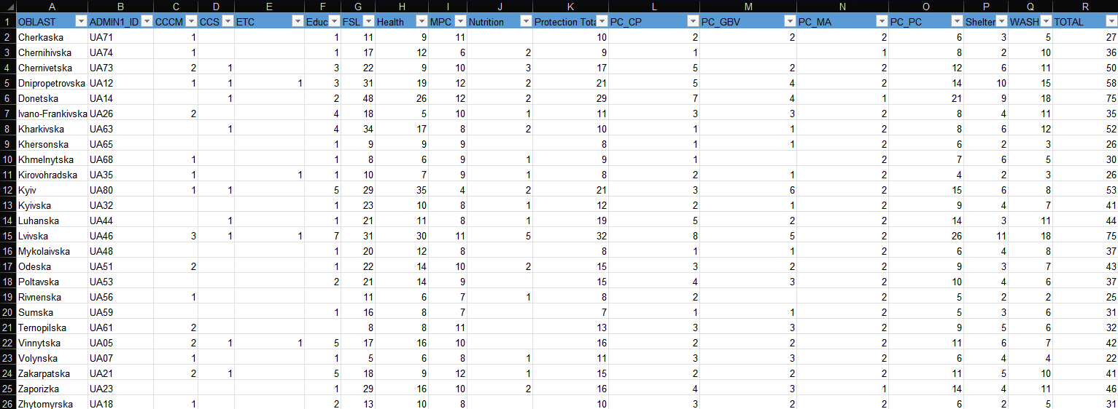
Ukraine: Who Does What, Where (3W/5W)
People Reached
Number of Organizations
30 rounds
Excel Format
Ukraine: Who Does What, Where (3W/5W)
https://data.humdata.org/dataset/ukraine-who-does-what-where-3w

Slide 14
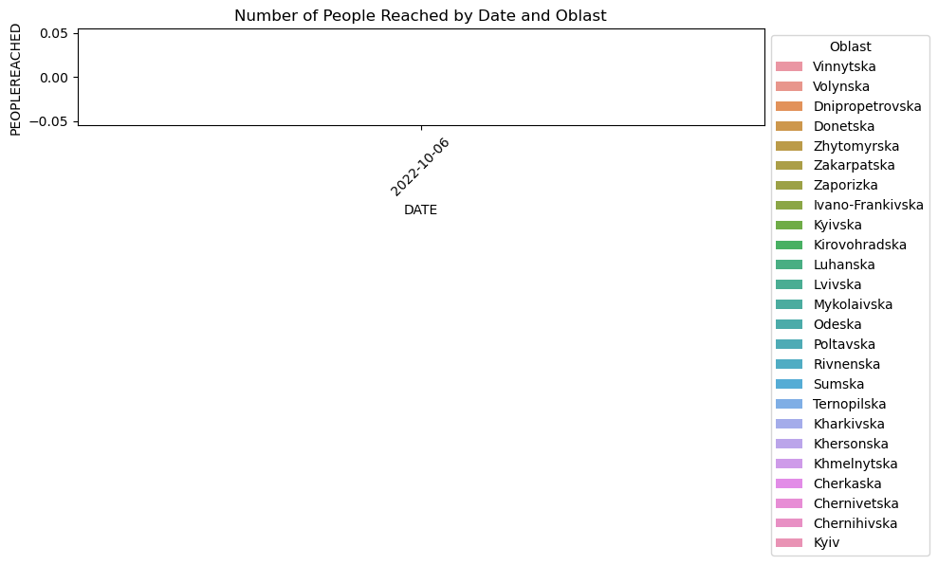
Paste an image
Pre-Interpolation
We used 30 rounds (weeks) of data starting from round 8 and ending with round 37
There were 3 rounds with missing data: 30, 33, 34
We had to replace these rounds
We chose to use interpolation over using average or dropping values to maintain time-series data

Slide 15
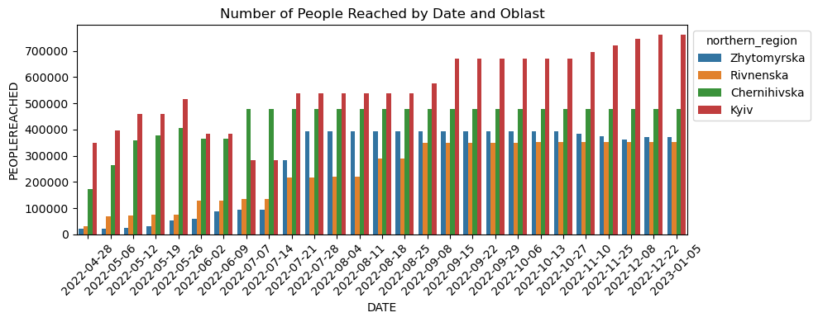
Interpolation
Interpolation involves estimating values within a set of known data points. It takes into account the relationship between the known points and uses that relationship to make predictions about values in between.
Paste an image

Slide 16

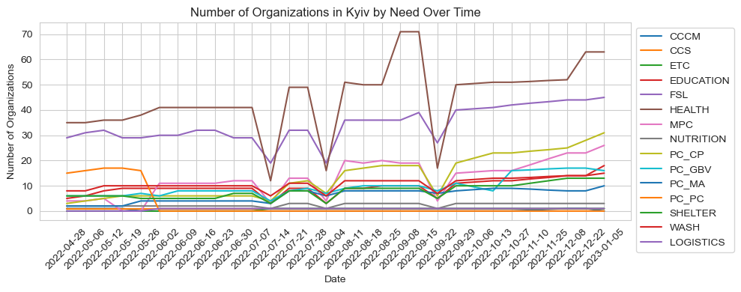
Taking a closer look…

Slide 17
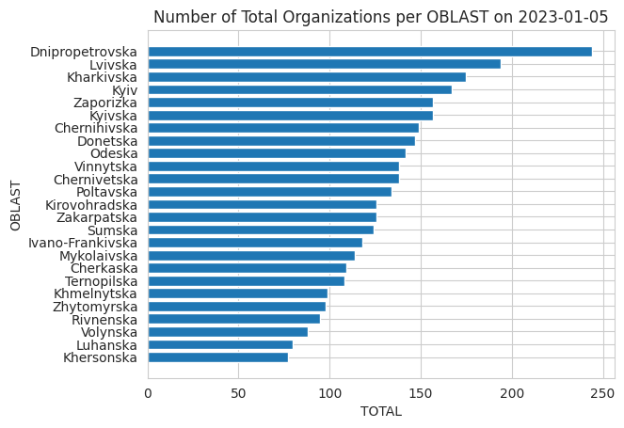
Latest Situation in Ukraine
As we observed data, the latest update we have is for January 5th, 2023. On this date, Dnipropetrovska oblast required the most help as it has the top number of organizations helping there on this date. The next top organizations that needed help were Lvivska, Kharkivska, Kyiv, and Zaporizka.
🗸 Our goal is to make a model that predicts such data for future needs.

Slide 18
Modeling & Evaluation

Slide 19
Model Comparison
Model Name | Description | Results | Pros | Cons
Linear Regression | Predictions based on a linear data relationship. | Moderate RMSE and R² accuracy; could be improved upon. | Simple implementation | Works best for linear data (not our case)
Gradient Boosting Regression | Subsequent models are improved based on past model residuals. | Low RMSE and high R² scores. | Appropriate for non-linear data. Good predictive accuracy, flexible | Can overfit, computationally expensive
Random Forest Regression | Ensemble method that constructs a multitude of decision trees | High MSE and high RMSE scores | Flexible, can handle variety of features. | Complex model, slow decision making-speed

Slide 20
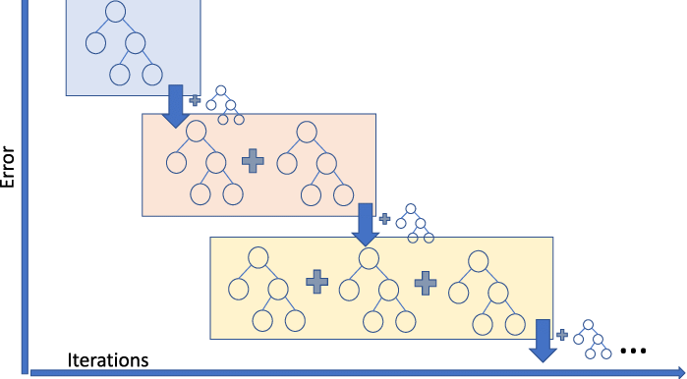
Gradient Boosting Regression
Why Gradient Boosting Regression?
High accuracy
Good with Nonlinear data
Good with Tabular data
Can handle different data types (numerical and categorical)
What we did:
Initial algorithm - simple base model
Evaluating model’s accuracy - Mean Squared Error and R-squared
Adjusting max_depth and n_estimators based on grid search
Comparing actual values vs predicted values
Evaluating feature importance
Looking for solutions for improvement
What is Gradient Boosting Regression?
Gradient boosting is one of the variants of ensemble methods where you create multiple weak models (decision trees) and combine them to get better performance as a whole.*
Gradient Boosting Technique *²
Notes:
*Masui, Tomonori. “All You Need to Know about Gradient Boosting Algorithm − Part 1. Regression.” Medium, Towards Data Science, 12 Feb. 2022, towardsdatascience.com/all-you-need-to-know-about-gradient-boosting-algorithm-part-1-regression-2520a34a502.
*²Shetty, Charanraj. “Gradient Boosting Technique.” Medium, Towards AI, 20 Dec. 2020, pub.towardsai.net/gradient-boosting-technique-b3dbb7069b74.

Slide 21
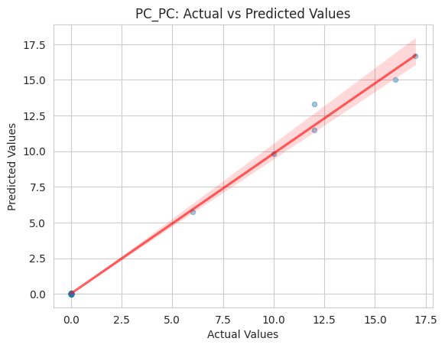
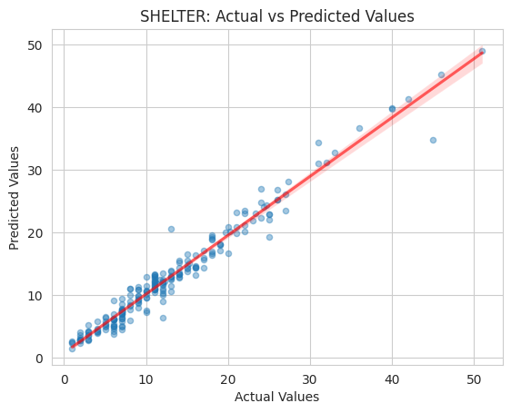
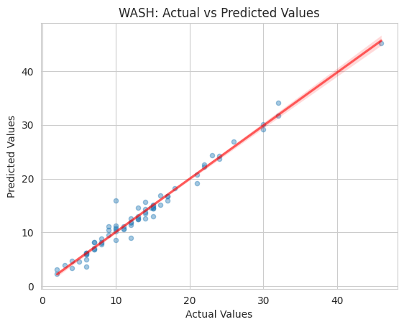
Form of Child Protection, Shelter, and WASH (Water, Sanitation and Hygiene)
Hyperparameter tuning with Grid Search for n_estimators and max_depth
Gradient Boosting Regressor approach
Form of Child Protection (PC_PC)
RMSE: ~0.25
R2: ~ 0.99
Shelter
RMSE: ~ 1.54
R2: ~ 0.96
WASH
RMSE: ~ 1.04
R2: ~ 0.98

Slide 22
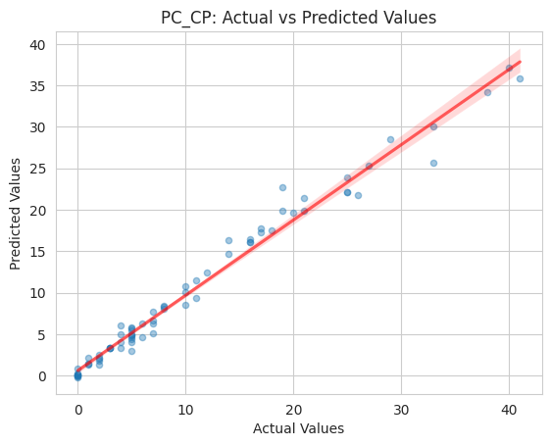
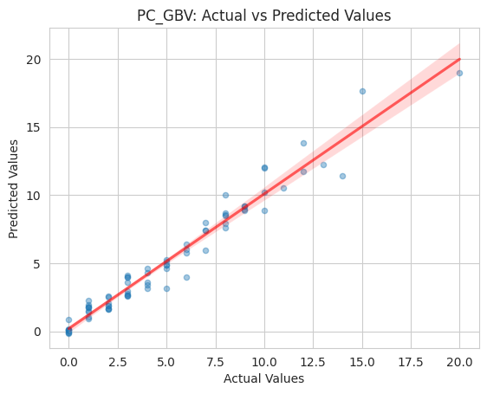
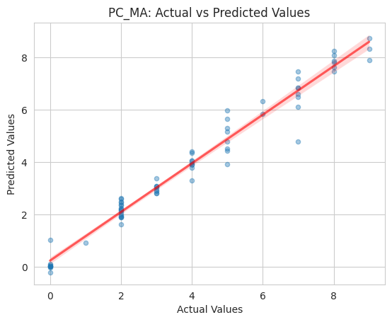
Child Protection, Gender-Based Violence,
Mine Action
Hyperparameter tuning with Grid Search for n_estimators and max_depth
Gradient Boosting Regressor approach
Child Protection (PC_CP)
RMSE: ~1.641
R²: ~0.976
Gender-Based Violence (PC_GBV)
RMSE: ~0.867
R²: ~0.957
Mine Action (PC_MA)
RMSE: ~0.469
R²: ~0.967

Slide 23
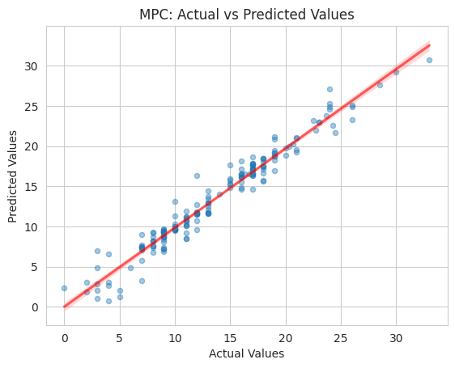
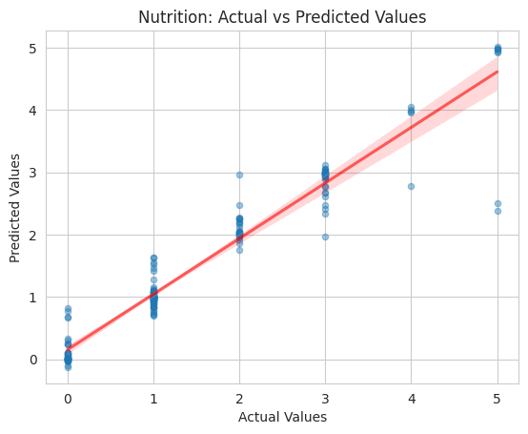
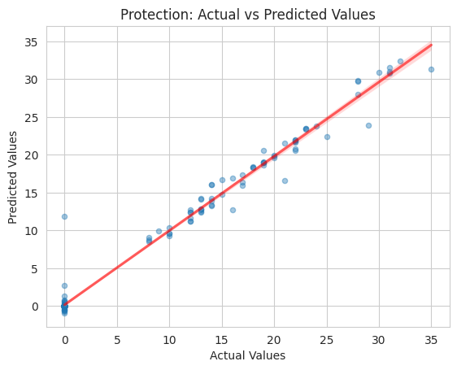
Multiple Purpose Cash, Nutrition, Protection
Hyperparameter tuning via GridSearch for ‘n_estimators’ and ‘max_depth’
Gradient Boosting Regressor approach
Multiple Purpose Cash (MPC)
RMSE: ~1.565
R²: ~0.956
Nutrition
RMSE: ~0.127
R²: ~0.926
Protection
RMSE: ~1.345
R²: ~0.986

Slide 24
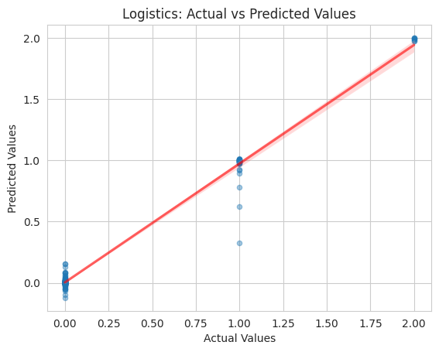
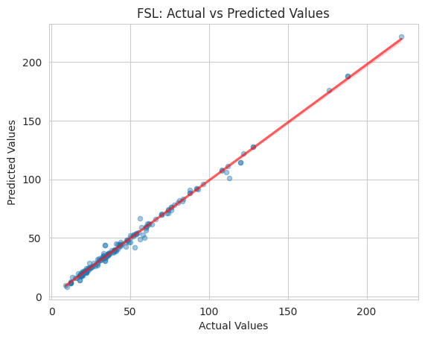
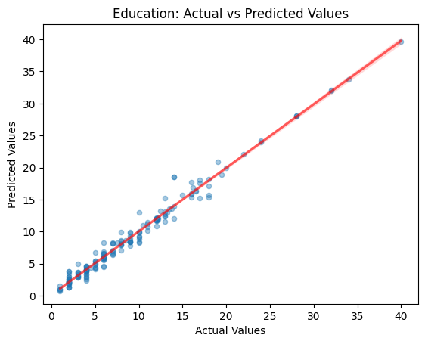
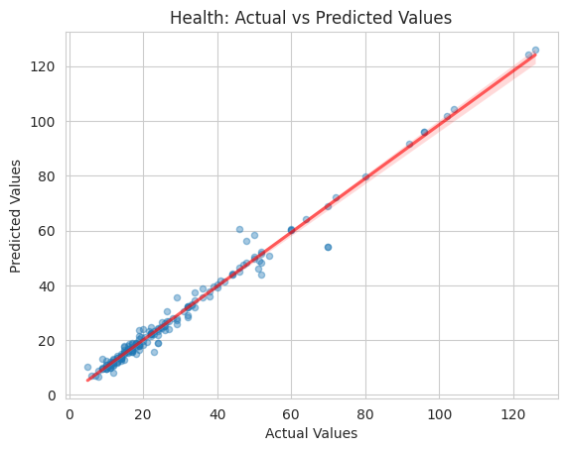
Education, Food Security and Livelihoods, Health, Logistics
Hyperparameter tuning via GridSearch for ‘n_estimators’ and ‘max_depth’
Gradient Boosting Regressor approach
Education
RMSE: ~0.915
R²: ~0.982
Food Security and Livelihoods (FSL)
RMSE: ~2.798
R²: ~0.993
Health
RMSE: ~2.753
R²: ~0.984
Logistics
RMSE: ~.0666
R²: ~0.984

Slide 25
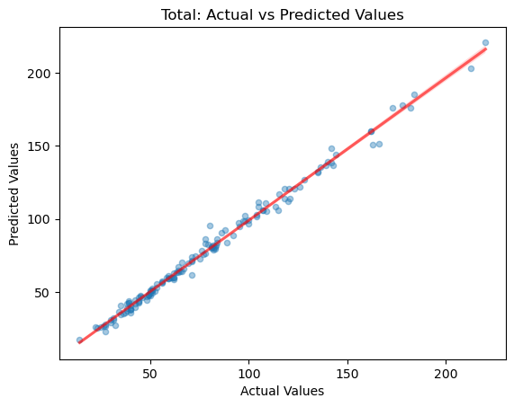
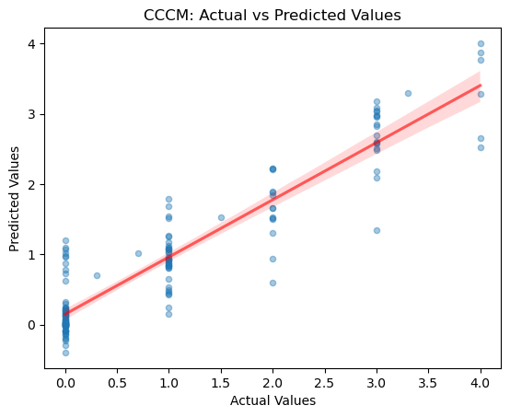
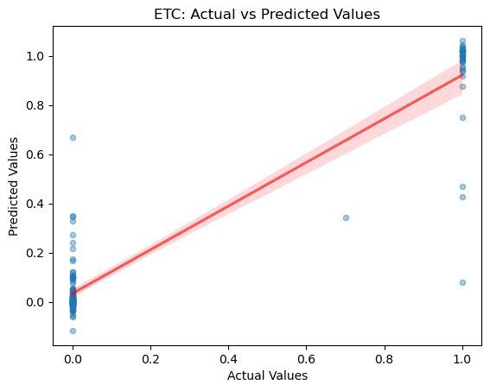
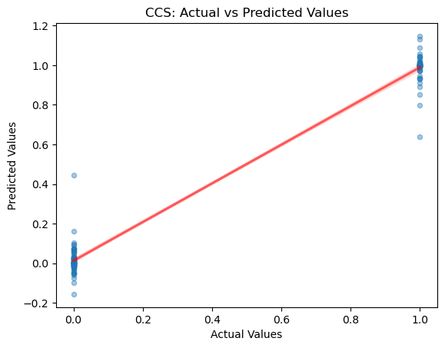
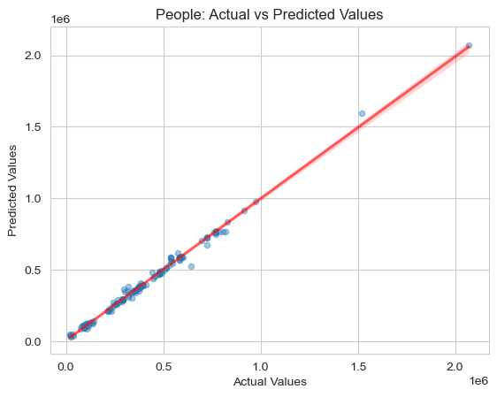
Total, CCCM and CCS, ETC,People Reached
Hyperparameter tuning via GridSearch for ‘n_estimators’ and ‘max_depth’
Gradient Boosting Regressor approach
Total (Organizations)
RMSE: ~3.68
R²: ~0.99
Camp Coordination & Camp Management (CCCM)
RMSE: ~0.43
R²: ~0.87
Coordination and Common Services (CCS)
RMSE: ~1.345
R²: ~0.986
Emergency Telecommunications (ETC)
RMSE: ~.07
R²: ~0.98
People Reached
RMSE: ~21340
R²: ~0.98

Slide 26
Insights and Key Findings
We learned valuable information based on the feature importance: some needs depend mainly on several other features, which means we do not need all the data to make future predictions.
Working with organization data gave us better predictions over people-reached data. The people reached data was harder to work with as some people got help with several needs. Organizations tend to help with one particular need.
Some features like date and oblast had to be encoded to convert categorical variables to numerical values.
All our models performed well (90%+ accuracy). There is a potential of combining all the models in one united model that could perform well predicting several needs at the same time.
Some features were driving many of the needs’ predictions. Collecting data for these features can help us make faster and more accurate predictions for other needs.
Notes:
As we cannot make future predictions due to the lack of new data, we have decided to look at feature importance and see what features each need depend on the most. This will help us to predict some needs with only a few features instead of gathering all the data for all the needs (next slide for more).

Slide 27
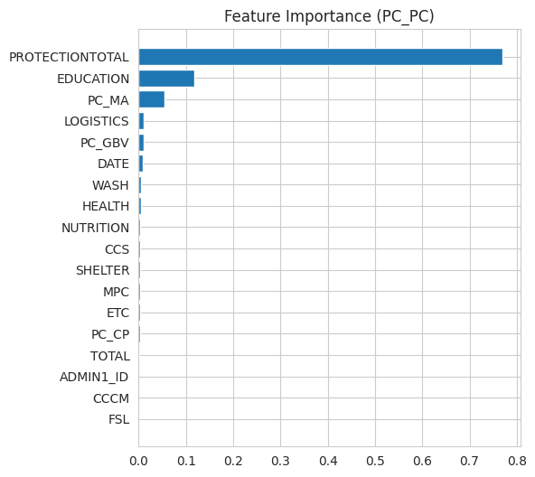
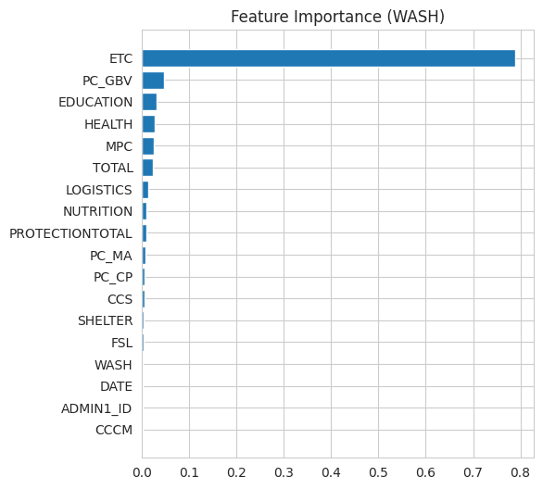
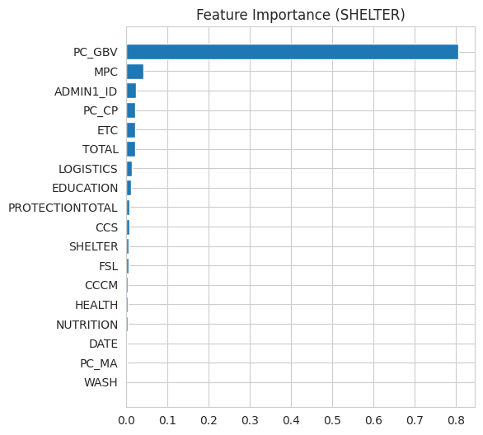
Feature Importance (1)
Form of Child Protection (PC_PC) mainly relies on: Protectional Total, Education, and Mine Action (PC_MA).
Shelter mainly relies on: Gender-Based Violence (PC_GBV), Multiple Purpose Cash (MPC), and Child Protection (PC_CP).
Water, Sanitation, and Hygiene mainly relies on: Emergency Telecommunications (ETC), Gender-Based Violence (PC_GBV), and Education.
Notes:
Code Source: https://scikit-learn.org/stable/auto_examples/ensemble/plot_gradient_boosting_regression.html
Note: some of the graphs indicate that the need is dependent on itself, so we ignore this. ADMIN_1D is dropped

Slide 28
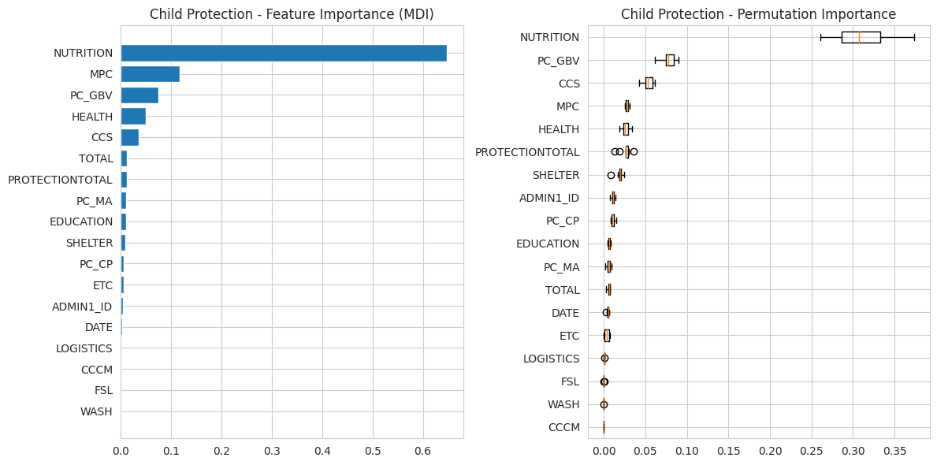
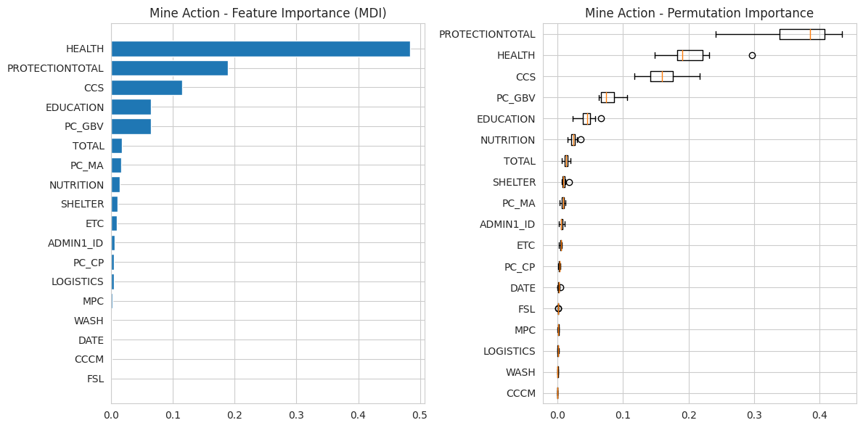
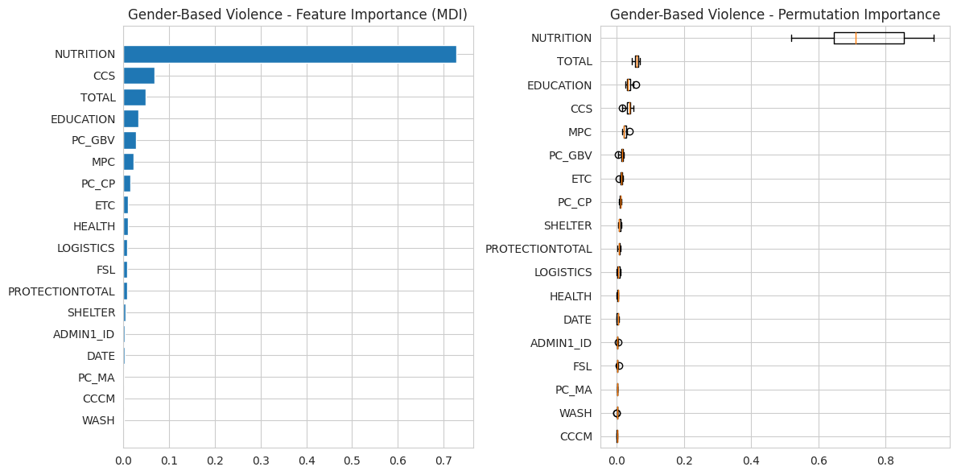
Feature Importance (2)
Child Protection mainly relies on: Nutrition, Multiple Purpose Cash (MPC), Gender-Based Violence (PC_GBV), Health.
Gender-Based Violence mainly relies on: Nutrition, Coordination and Common Services (CCS), Total (Organizations).
Mine Action mainly relies on: Health, Total Protection, Coordination and Common Services (CCS), Education, Gender-Based Violence (PC_GBV).
Notes:
Code Source: https://scikit-learn.org/stable/auto_examples/ensemble/plot_gradient_boosting_regression.html
Note: some of the graphs indicate that the need is dependent on itself, so we ignore this.

Slide 29
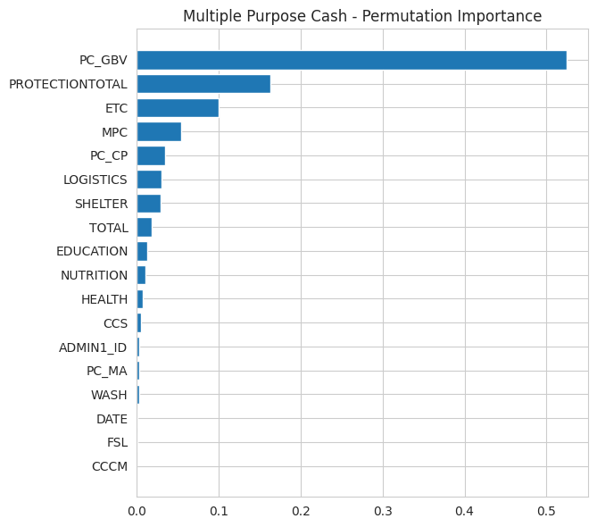
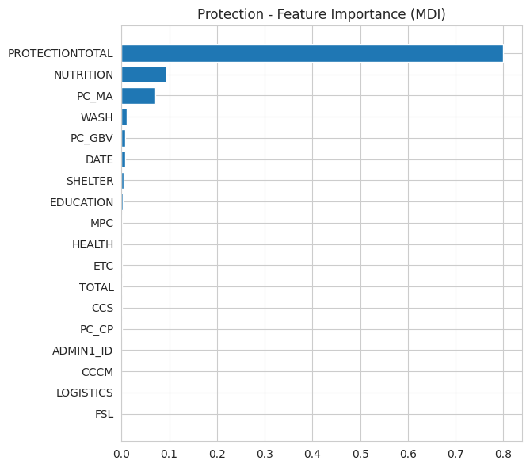
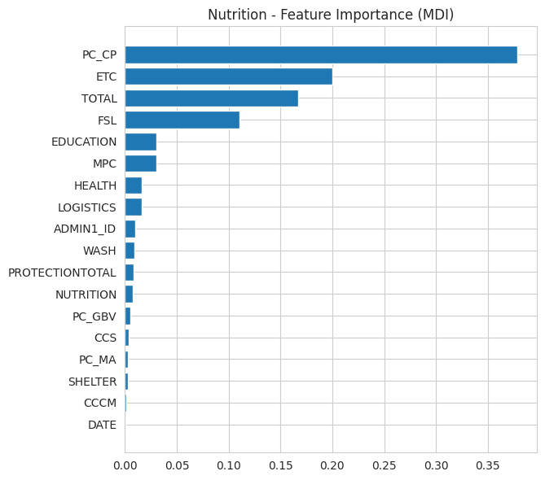
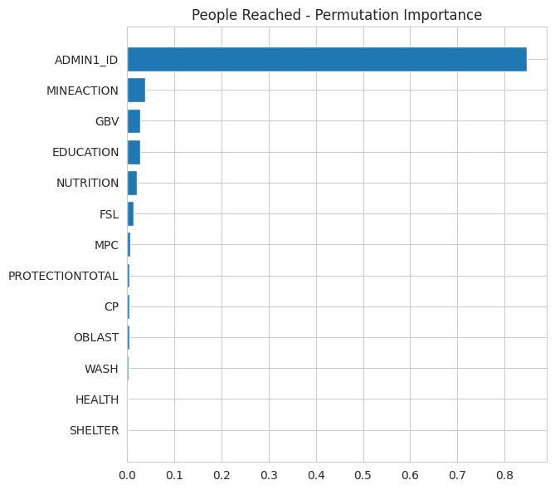
Feature Importance (3)
Multiple Purpose Cash mainly based on: Gender-Based Violence (PC_GBV), Protection Total, Emergency Telecommunications (ETC).
Protection Total mainly based on: Nutrition, Mine Action (PC_MA), Water, Sanitation and Hygiene (WASH).
Nutrition mainly based on: Child Protection (PC_CP), Emergency Telecommunications (ETC), Total (Organizations), Food Security and Livelihoods (FSL).
People Reached mainly based on Mine Action, Gender-Based Violence (GBV), Education, Nutrition.
Notes:
Code Source: https://scikit-learn.org/stable/auto_examples/ensemble/plot_gradient_boosting_regression.html
Note: some of the graphs indicate that the need is dependent on itself, so we ignore this.

Slide 30
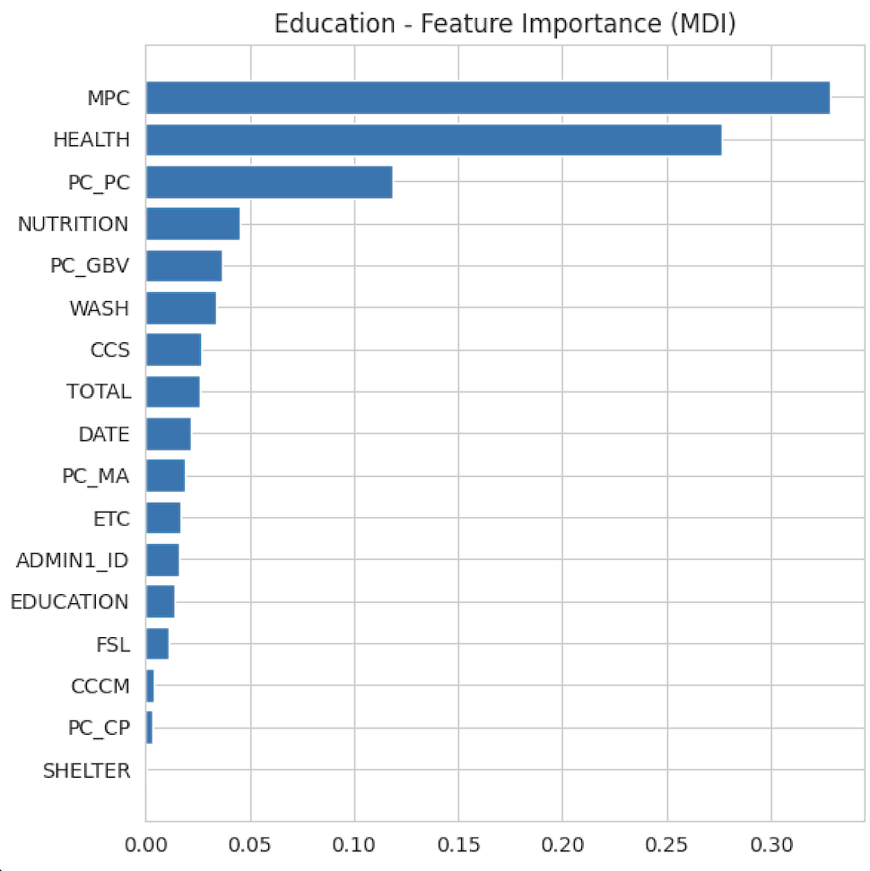
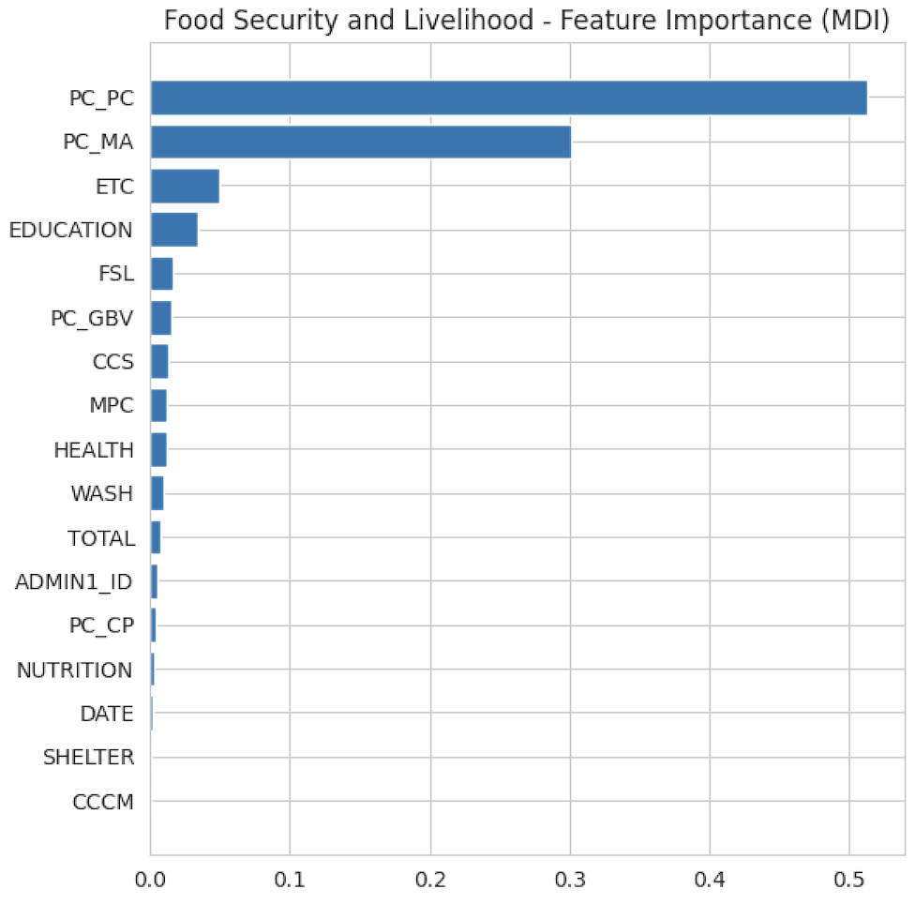
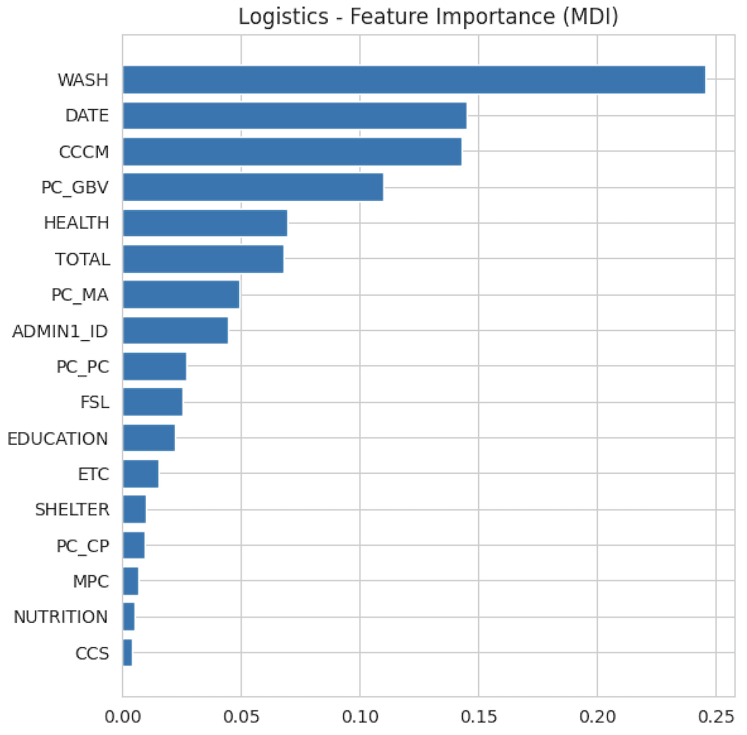
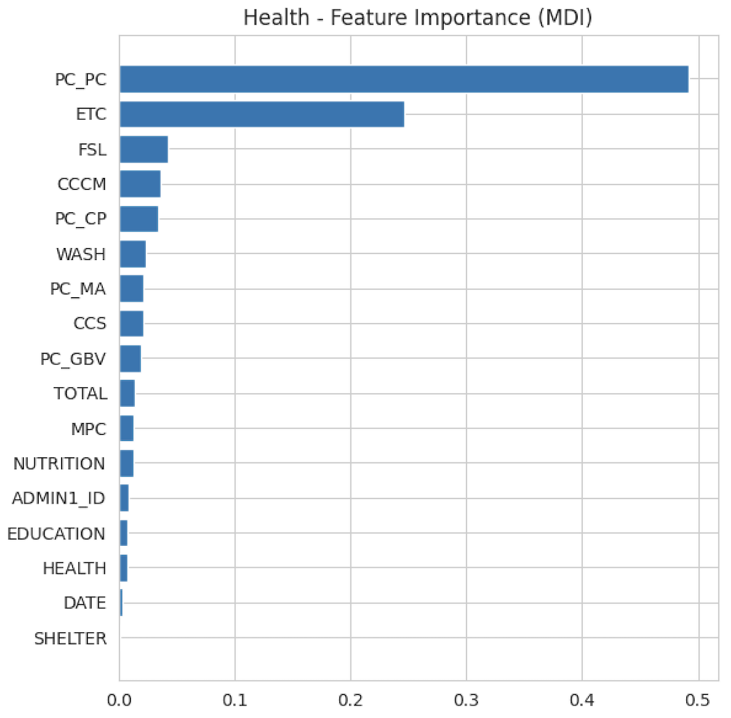
Feature Importance (4)
Education mainly based on: Multiple Purpose Cash (MPC), Health, Form of Child Protection (PC_PC).
Food Security and Livelihood mainly based on: Form of Child Protection (PC_PC), Mine Action (PC_MA), Emergency Telecommunications (ETC).
Logistics mainly based on: Water, Sanitation and Hygiene (WASH), Date, Camp Coordination and Camp Management (CCCM).
Health mainly based on: Form of Child Protection (PC_PC), Emergency Telecommunications (ETC), Food Security and Livelihoods (FSL).
Notes:
Code Source: https://scikit-learn.org/stable/auto_examples/ensemble/plot_gradient_boosting_regression.html
Note: some of the graphs indicate that the need is dependent on itself, so we ignore this.

Slide 31
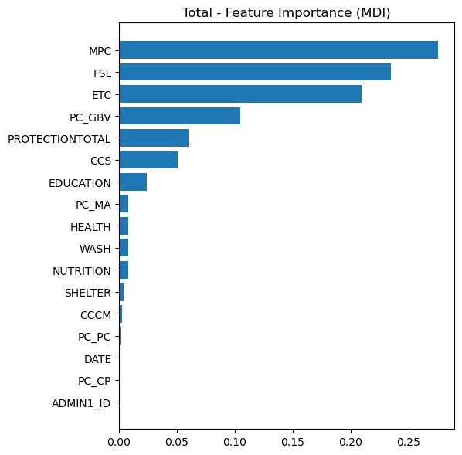
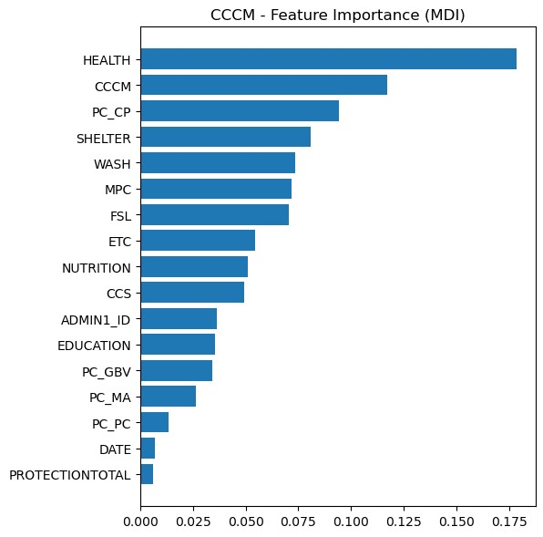
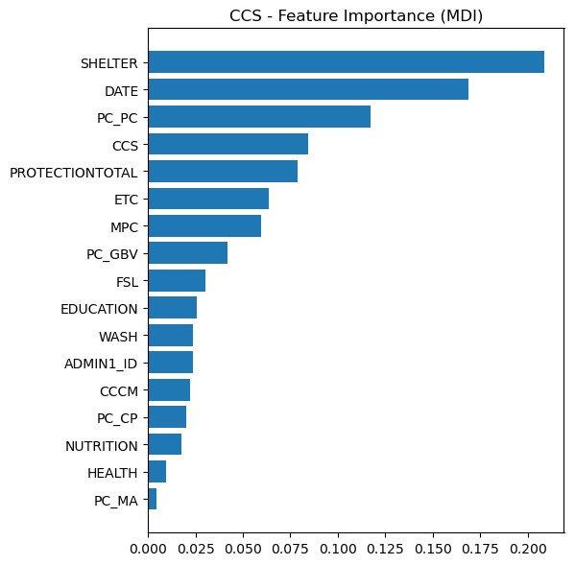
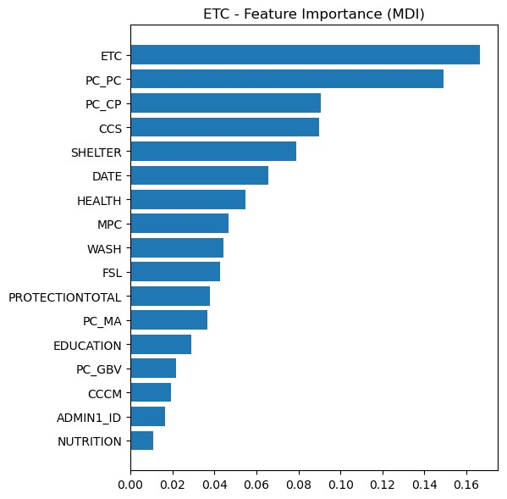
Feature Importance (5)
Total Organizations mainly based on: Multiple Purpose Cash (MPC), Food Security and Livelihoods (FSL), Emergency Telecommunications (ETC).
Camp Coordination and Camp Management (CCCM) mainly based on: Health, Child Protection (PC_CP), Shelter.
Coordination and Common Services (CCS) mainly based on: Shelter, Date, Form of Child Protection (PC_PC).
Emergency Telecommunications (ETC) mainly based on: Form of Child Protection (PC_PC), Child Protection (PC_CP), Coordination and Common Services (CCS).
Notes:
Code Source: https://scikit-learn.org/stable/auto_examples/ensemble/plot_gradient_boosting_regression.html
Note: some of the graphs indicate that the need is dependent on itself, so we ignore this.

Slide 32
Feature Importance (Conclusion)
As we were creating our models we were going for the best accuracy (90%+) which resulted in us using the majority of other needs as features. Feature Importance graphs helped us to understand the dependencies of each need on other needs.
Now we can see that we can use each model to make predictions using top features instead of the majority of them. That is helpful for making future predictions as we realistically won’t have all the data available. This gives us an opportunity to use newly available data to draw conclusions.

Slide 33
Final Thoughts

Slide 34
What We Learned
It’s easier to start with a less complex model then build up
Linear interpolation is a valuable data preparation tool for data involving time
It is okay to change plans if something does not work out
Be open to try various models to find what would work best with the data
Consistent communication is important in order to accomplish the tasks
Reach out for help if needed
Visualizations can help explain results to those who are not involved with the project
We learned how to utilize new resources for collaboration purposes
It may be challenging to find the dataset that suits our problem

Slide 35
Potential Next Steps
Utilize more datasets that provide insightful, important data regarding humanitarian needs
Utilize the date feature to implement a timer series model
Combining models into one model (potentially using Neural Network Regression)
Deploying the model to be used with new data to predict future needs
Optimize the model - explore if there are more complex, better hyperparameters, and algorithms that can be used to make better predictions
Monitor the performance of the model after deployment and make improvements
Make analysis and conclusions based on the predicted values after deployment
As several teams were working on this project, we can communicate with them to compare our findings, insights, and experience to help improve our models and/or collaborate on creating a new, better model

Slide 36

Thank you!
Any Questions?

